Slide 1
Lead Scoring Case Study
Presented By:
Pritamkumar Suryavanshi
Abhishek N R

Slide 2
Problem Statement
An education company named X Education sells online courses to industry professionals. On any given day, many professionals who are interested in the courses land on their website and browse for courses.
The company markets its courses on several websites and search engines like Google. Once these people land on the website, they might browse the courses or fill up a form for the course or watch some videos. When these people fill up a form providing their email address or phone number, they are classified to be a lead. Moreover, the company also gets leads through past referrals. Once these leads are acquired, employees from the sales team start making calls, writing emails, etc. Through this process, some of the leads get converted while most do not. The typical lead conversion rate at X education is around 30%.
Now, although X Education gets a lot of leads, its lead conversion rate is very poor. For example, if, say, they acquire 100 leads in a day, only about 30 of them are converted. To make this process more efficient, the company wishes to identify the most potential leads, also known as ‘Hot Leads’. If they successfully identify this set of leads, the lead conversion rate should go up as the sales team will now be focusing more on communicating with the potential leads rather than making calls to everyone.
As you can see, there are a lot of leads generated in the initial stage (top) but only a few of them come out as paying customers from the bottom. In the middle stage, you need to nurture the potential leads well (i.e. educating the leads about the product, constantly communicating etc. ) in order to get a higher lead conversion.
X Education has appointed you to help them select the most promising leads, i.e. the leads that are most likely to convert into paying customers. The company requires you to build a model wherein you need to assign a lead score to each of the leads such that the customers with higher lead score have a higher conversion chance and the customers with lower lead score have a lower conversion chance. The CEO, in particular, has given a ballpark of the target lead conversion rate to be around 80%.

Slide 3
Goal
To build a logistic regression model to assign a lead score between 0 and 100 to each of the leads which can be used to target potential leads. A higher score would mean that the lead is hot i.e. is most likely to convert whereas lower score would mean that the lead is cold and will not get converted.

Slide 4
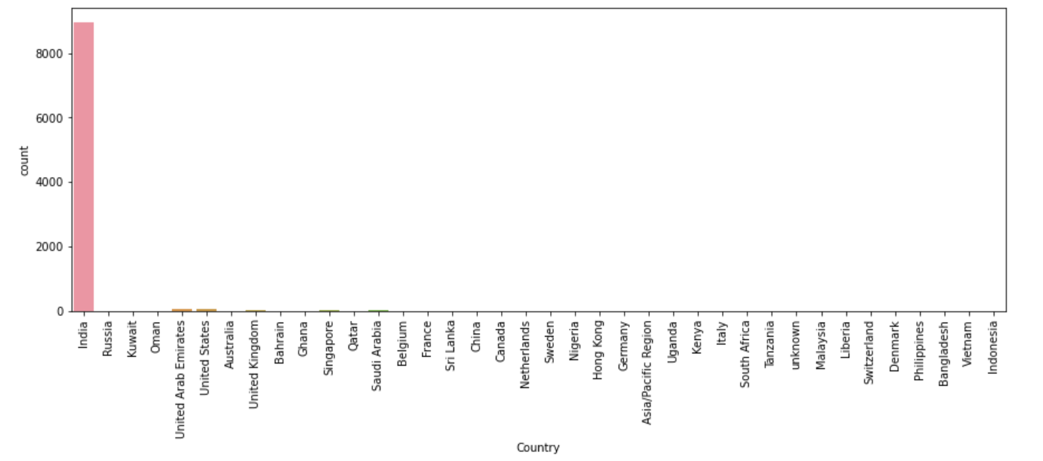
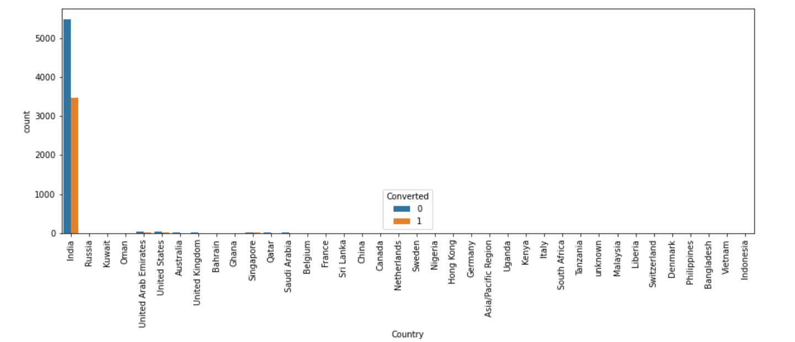
Exploratory Data Analysis
Univariate Bivariate Analysis
We can clearly see that country column is completely dominated by India.
When we plot country against target variable we can clearly see that peoples from India have converted the most
Variable is completely skewed towards India.

Slide 5
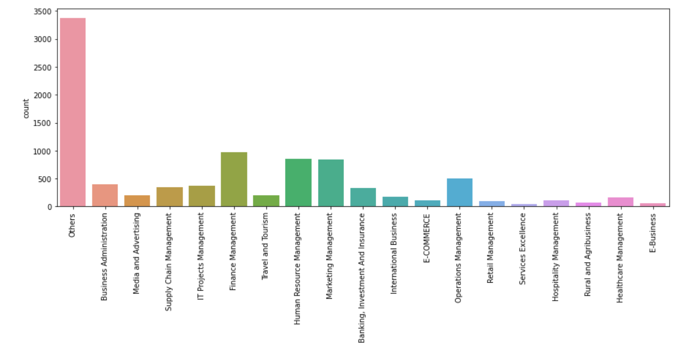
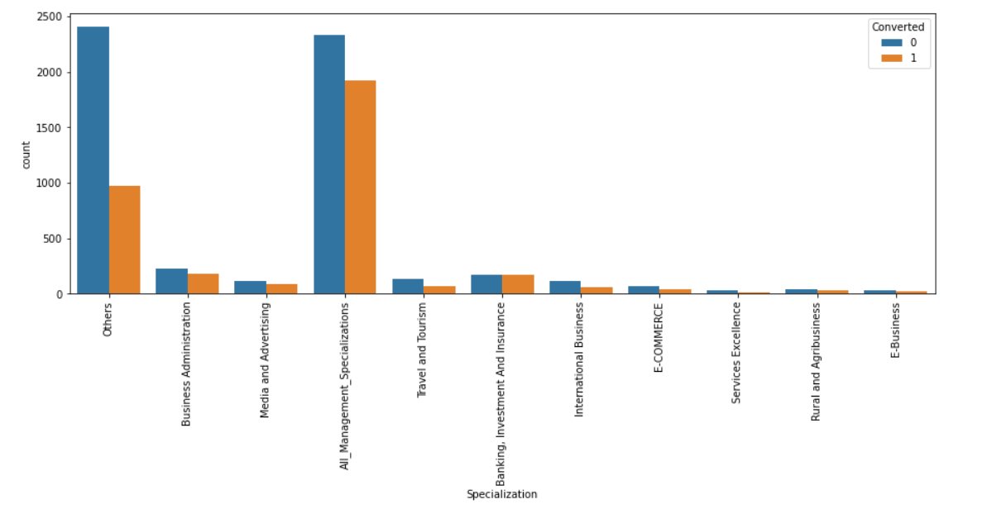
Specialization
If we look at first plot we can clearly see that most of them have not selected the specialization.
Other than others we can see most of the peoples have showed there interest in Management specialization.
We have combined all management course to one course and plotted a count graph to check how management course performing.
From plot 2 we can clearly see that management course has very good conversion rate.

Slide 6
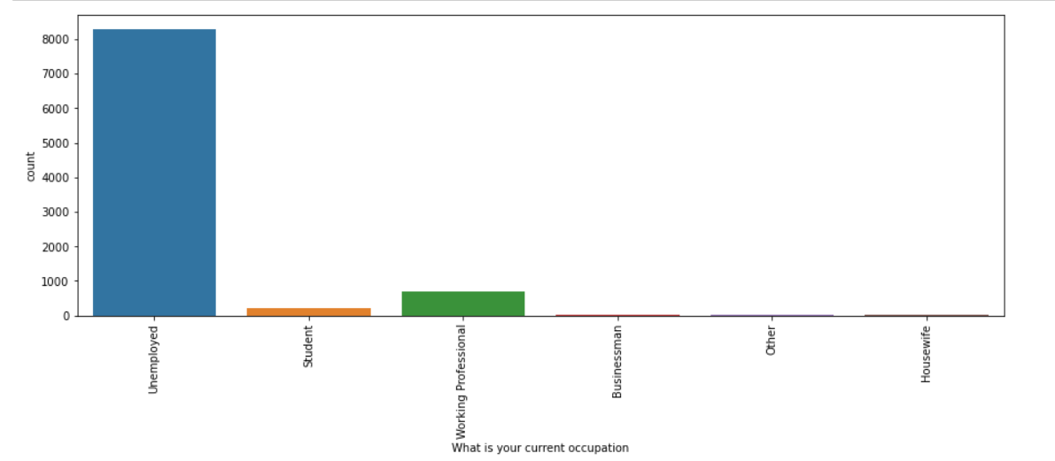
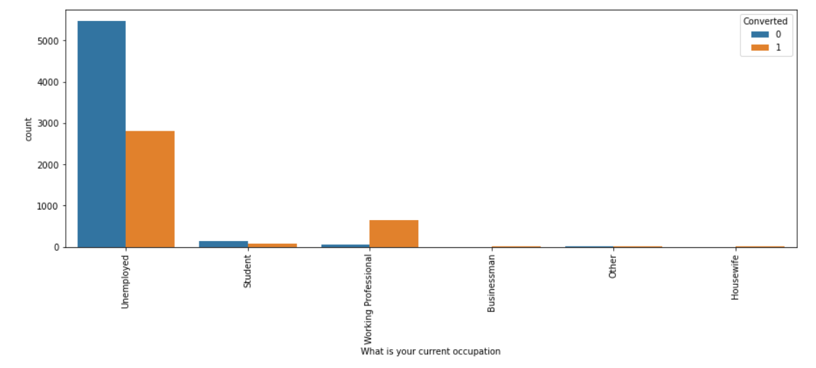
Occupation
From the plot its obvious that peoples who have filled the form are mostly unemployed.
From plot 2 we can visualize that unemployed has a good conversion rate.
From our analysis so far we can say that company should target peoples from India and who are unemployed.

Slide 7
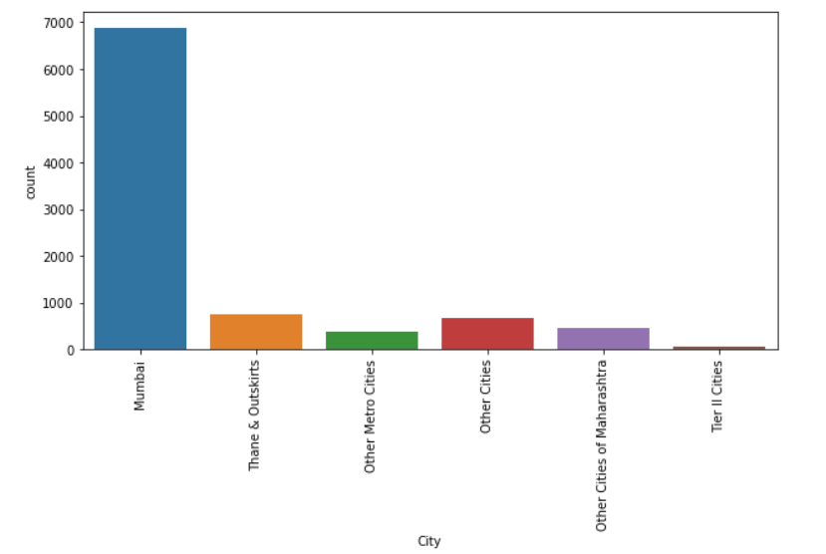
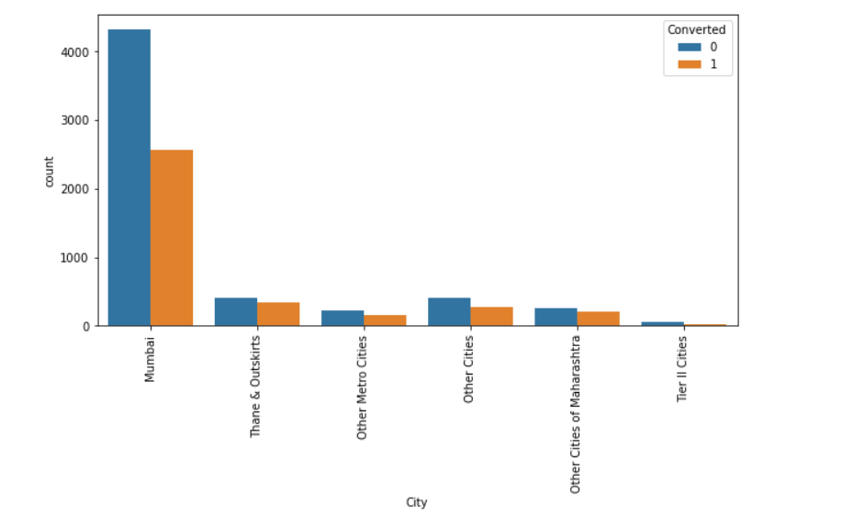
City
From first plot we can observe that majority of the peoples are from Mumbai.
From second plot it clear that peoples from Mumbai are the most converted.
Company should concentrate more on the peoples who belongs to Mumbai.
From our initial analysis company should concentrate more on peoples from India and who belongs to city Mumbai.

Slide 8
Missing Values
- In data we found the presence of select values. We replaced the select with nan and started the missing value analysis.
- We dropped the columns having missing value percent greater than 40.
- We dropped few rows which has more than 10 entries missing.
- After dropping we imputed the missing values for remaining columns using suitable methods.

Slide 9
After the initial analysis we have identified few columns which are completely skewed and few columns which are score variables.
For further analysis we need to drop this columns as skewed columns might bias our output.
The columns which we have dropped are:
- Do Not Call
- Search
- Magazine
- Newspaper Article
- X Education Forums
- Tags
- Digital Advertisements
- Through Recommendations
- Receive More Updates About Our courses
- Update Me on Supply Chain Content
- What matters most to you in choosing a course
- A free copy of Mastering The Interview
- Get Updates on DM Content
- I agree to pay the amount through cheque

Slide 10
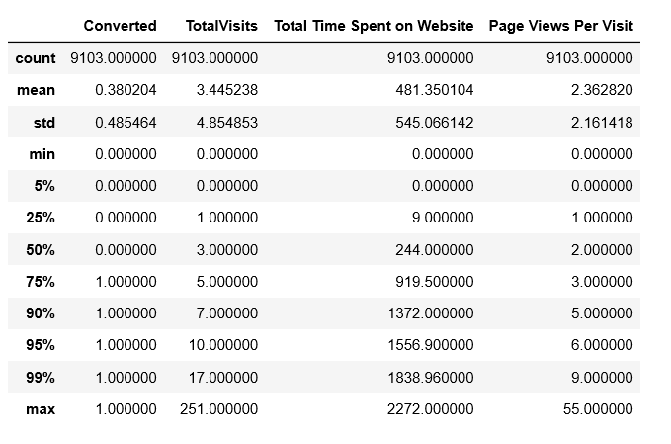
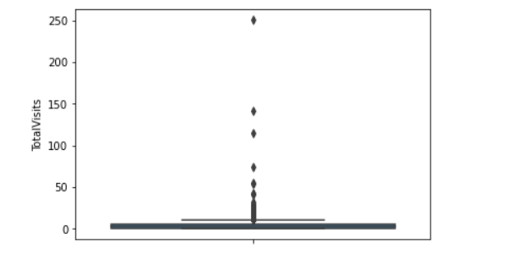
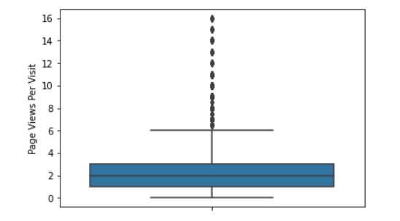
Outlier Analysis
From plot one we can see for TotalVisits there is a significant difference between 99% and max value, this is created due to the presence of outliers.
Similarly we can see there is a significant difference between 99% and max value for Page Views Per Visit as well.
From Plot 2 and 3 we can conclude the presence of outliers in TotalVisits and Page Views Per Visit.
Outliers are treated by removing all the values above 99% and below 1%

Slide 11
Dummy Variable Creation
- We identified few categorical columns for creating dummies.
- The variables are as follows
- Lead Origin
- Lead Source
- Last Activity
- Specialization
- What is your current occupation
- City
- Last notable activity
- We created the dummies for above mentioned variables and dropped the first one.
- After the creation of dummies we have dropped the original variable as well.

Slide 12
Model Building
Now we start with model building process by splitting test and train data.
- Before Splitting we dropped the target variable from the data set.
- After splitting we performed Scaling on train data set to bring all variables to same scale.
- We did feature scaling using RFE.
- Initially we took 25 variables for our model building

Slide 13
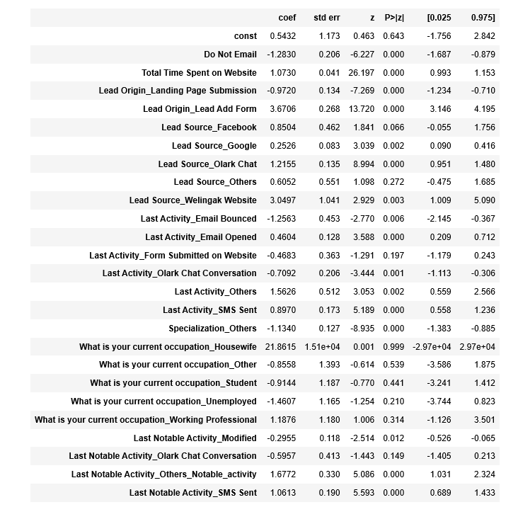
Model 1
We got this model after RFE feature selection.
We can see from the stats that this is not the great model, because it has lot of variables and few variables are highly correlated(few variables have high p-value).
Now we have 25 features and model-1 by using manual feature selection and VIF we kept on removing the features one by one which are insignificant.
The Final model we built is show in next slide.

Slide 14
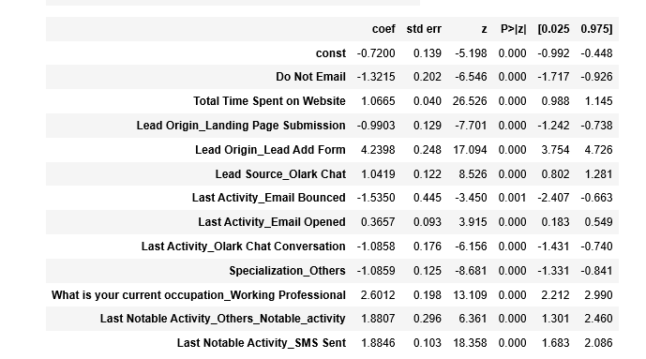
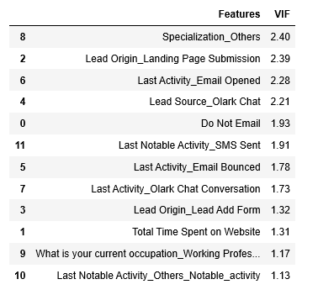
Final Model
The Final model which we have got has 12 features and has p-value less than 0.05
And the model has VIF less than 5.
The Accuracy we are getting from the model is 81.424%
The sensitivity is 69.7%.
Top 3 features which are contributing to the model are:
Lead Origin_Lead Add Form
What is your current occupation_Working Professional
Last Notable Activity_SMS sent

Slide 15
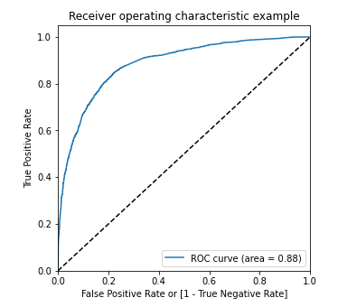
Plotting ROC Curve
Roc curve value should be closed to 1, we are getting a very good score of 0.88 which tell that our predictive model is good.

Slide 16
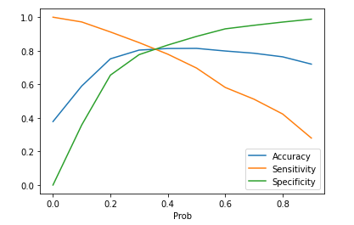
Finding Optimum Cut-off
From the plot we can confirm that optimum cut-off to be 0.35. Based on the business understanding and discussing with domain expert we can change the cut-off. From statistical point of view we will take 0.35 as probability cut-off.

Slide 17
Conclusion
From Test Data set
Accuracy = 80.86%
Sensitivity = 81.92%
Specificity = 80.86%
Precision = 71.57%
Recall = 81.92%
From Train Data set
Accuracy = 80.66%
Sensitivity = 81.80%
Specificity = 79.96%
Looking at the accuracy and sensitivity for both train and test data set we can clearly say that our predictive model is good as both accuracy and sensitivity are almost same.

